Slide 1
LIBRARY BOOK MANAGEMENT USING BINARY SEARCH TREES
TEAM-12
A25126510016
A25126510027
A25126510029
A25126510047
A25126510057

Slide 2

Problem Statement
Libraries face challenges managing large book collections efficiently.
Manual record keeping is error-prone and time-consuming.
Difficulty in quickly searching and updating book information.
Need for an automated system to track book availability and status.
Ensuring fast access to book records for issue and return processes.
Requirement for persistent storage to maintain data across sessions.

Slide 3
Objectives
Store book details using a Binary Search Tree.
Search a book quickly by Book ID.
Add and delete books without breaking tree order.
Display all books in sorted order.
Issue and return books and calculate fine for late return.
Save and load data using books.txt.

Slide 4
Proposed System
BST with Book ID as the key.
Smaller ID goes left, larger goes right.
Search, insert, delete: O(log n) average.
Inorder traversal gives sorted output.
Issue, return and fine are built in.

Slide 5
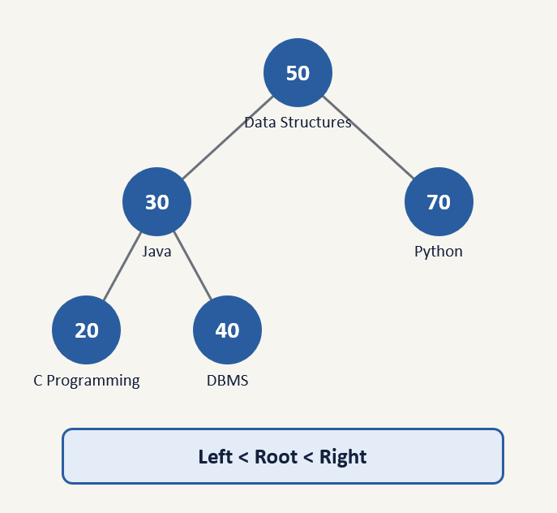
Binary Search Tree and Book Representation
A BST is a binary tree where each node has at most two children.
Rule: Left Subtree < Root < Right Subtree.
Duplicate Book IDs are rejected by the program.
Book ID is the key; each node holds the full book record.
Example: 50 Data Structures, 30 Java, 70 Python, 20 C Programming, 40 DBMS.

Slide 6
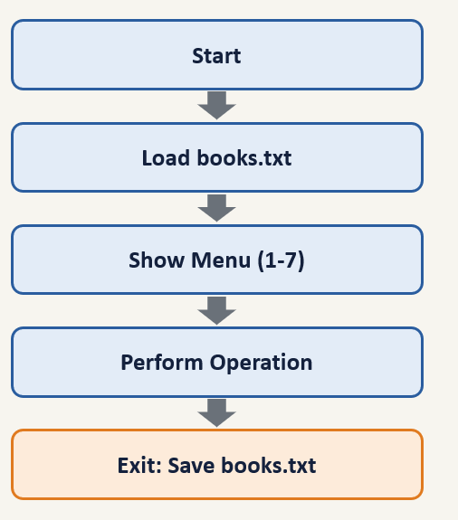
System Workflow
Start the program and load saved books from books.txt.
Show the menu with 7 options.
Read the choice: add, search, display, issue, return or delete.
Perform the operation on the BST, then return to the menu.
On Exit, save all books to books.txt and stop.

Slide 7
Insertion and Search Operation
Insert: compare the new ID with the current node; smaller goes left, larger goes right.
Repeat until an empty position is found, then place the node.
A duplicate ID prints "Book ID already exists!" and the node is freed.
Search: start at the root; equal means found, NULL means not found.
Example: searching 60 follows 50 → 70 → 60.
50
30
70
20
40
60
80
Orange: 40 inserted. Dark: search path for 60.

Slide 8
Deletion Operation
Case 1: No child
The node is simply removed.
Case 2: One child
The child replaces the deleted node.
Case 3: Two children
Copy the inorder successor (smallest ID in the right subtree) into the node, then delete the successor.
50
50
50
30
70
30
70
30
70
60
60
80
Delete 70: leaf removed.
Delete 70: 60 takes its place.
Delete 70: replaced by 80.

Slide 9
Tree Traversal
50
Traversal means visiting every node of the tree.
Inorder (Left → Root → Right) is used to display books.
It prints Book IDs in sorted order.
Code: inorder(left), print node, inorder(right).
30
70
20
40
60
80
Inorder output: 20 → 30 → 40 → 50 → 60 → 70 → 80

Slide 10
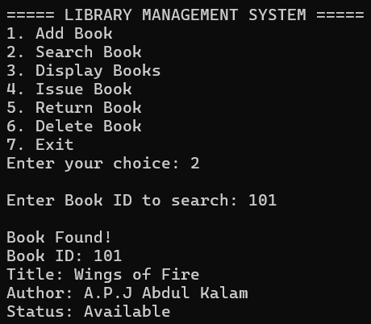
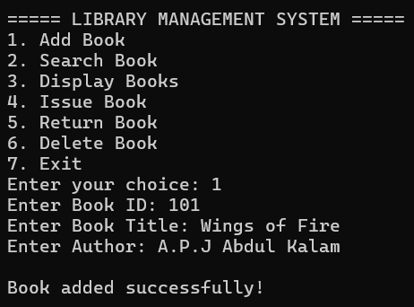
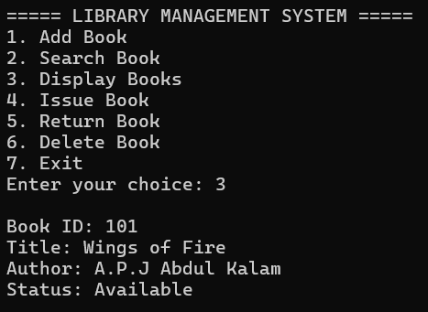
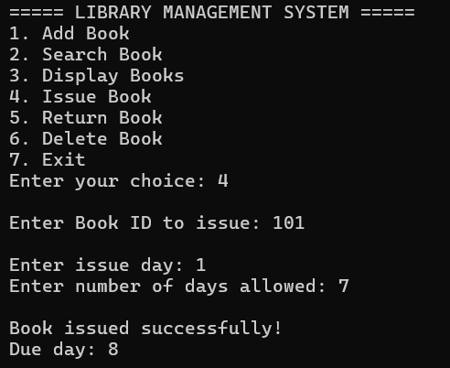
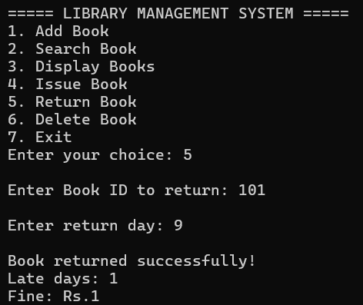
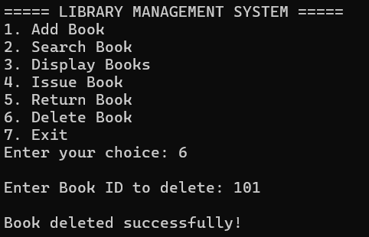
Output

Slide 11
Advantages
Fast search using BST structure
Sorted display with Inorder traversal
Simple file persistence using text
Easy extension for more features
Supports fine calculation for late
Conclusion
BST provides efficient book management
Code supports multiple library operations
File handling ensures data persistence
Project demonstrates data structures usage

Slide 12
THANK YOU
FROM
TEAM-12

